Slide 1


BiharKart! - A Ecommerce Website
Presented to
Department of CSE
Sitamarhi Institute of Technology
Aryabhatta Knowledge University, Patna
Presented by:
Prashant Kumar
16105127027
Shahbaz Alam
16105127017
Pankaj Kumar
16105127015
Rajesh Ram
16105127016
Guided by:
Mr. Neeraj Kumar
Assistant Professor
Department of CSE
SIT, Sitamarhi

Slide 2
INTRODUCTION
An E-Commerce portal which will allow formal and informal merchants in developing countries to advertise and sell their goods on the internet.
This would permit rural communities to make their wares available to the rest of the world via the World Wide Web.

Slide 3
OBJECTIVE
The objective of this project is to create an e-commerce web portal with a content management system which would allow product information to be updated.
The web portal will have an online interface in the form of an e-commerce website that will allow users to buy goods from the merchants.

Slide 4
MOTIVATION
To introduce new products and services.
To increase customer area of small shops.
To take advantage of brand name.
To enter the global market place.
To react to pressure from competitors.
To meet customers’ demand.
To increase sales.
To reduce transaction costs.
To reduce customer support costs.

Slide 5
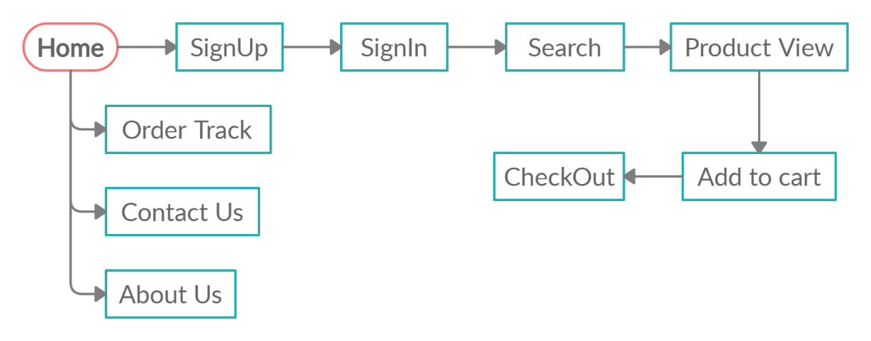
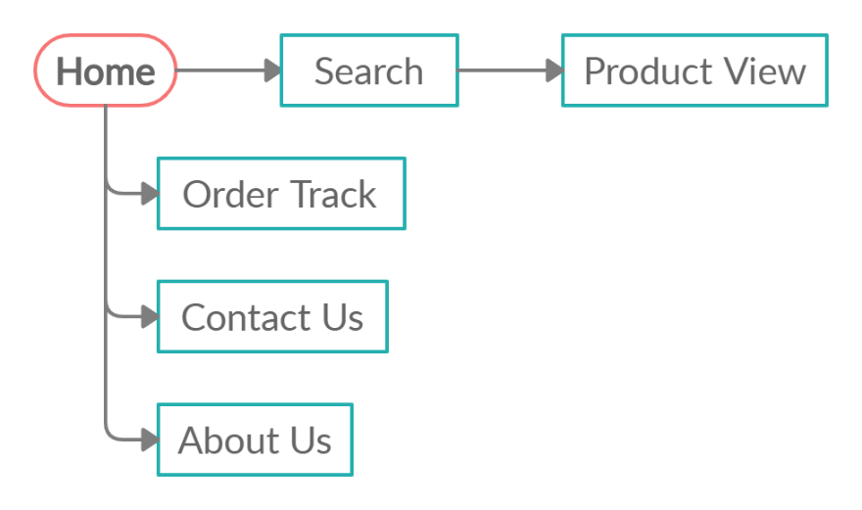
PROPOSED WORK
Normal User
Guest User

Slide 6
Technologies used to develop this Web Application
Django (Web framework)
Bootstrap (front-end framework)
Python
SQLite

Slide 7
Django (Web framework)
Django is a high-level Python Web framework that encourages rapid development and clean, pragmatic design.
Django's philosophy is to do all it can to facilitate hyper-fast development. Means less code so in turn a quick development.
Django has built-in support for Ajax, RSS, Caching and various other frameworks.
Django provides a nice ready-to-use user interface for administrative activities.
It is free and open source.

Slide 8
Bootstrap (front-end framework)
Bootstrap is a free and open-source CSS framework directed at responsive, mobile-first front-end web development.
The primary purpose of adding it to a web project is to apply Bootstrap's choices of color, size, font and layout to that project.
Each Bootstrap component consists of an HTML structure, CSS declarations, and in some cases accompanying JavaScript code.
Bootstrap comes with several JavaScript components in the form of jQuery plugins.
The most prominent components of Bootstrap are its layout components, as they affect an entire web page.

Slide 9
Python
Python is an interpreted, high-level, general-purpose programming language.
It is free and open source.
Python is dynamically typed and garbage-collected.
Python was conceived in the late 1980s as a successor to the ABC language.
The biggest strength of the Python is large library which can be used for GUI Apps, ML and many more.
Python is easy to learn and use. It is developer-friendly and high level programming language.
Python language is more expressive means that it is more understandable and readable.
It can be easily integrated with languages like C, C++, JAVA etc.

Slide 10
SQLite
SQLite is a relational database management system (RDBMS) contained in a C library.
SQLite is not a client–server database engine. Rather, it is embedded into the end program.
SQLite is ACID-compliant and implements most of the SQL standard, generally following PostgreSQL syntax.
SQLite is a popular choice as embedded database software for local/client storage in application software such as web browsers.
SQLite stores the entire database as a single cross-platform file on a host machine.
SQLite read operations can be multitasked, though writes can only be performed sequentially.

Slide 11
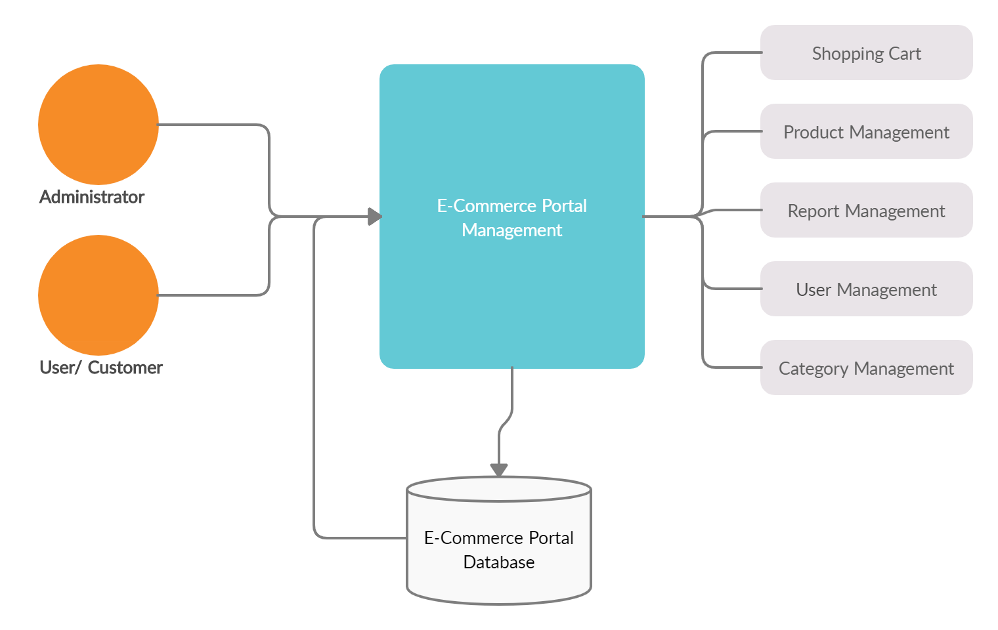
DFD of E-Commerce website
Level 0

Slide 12
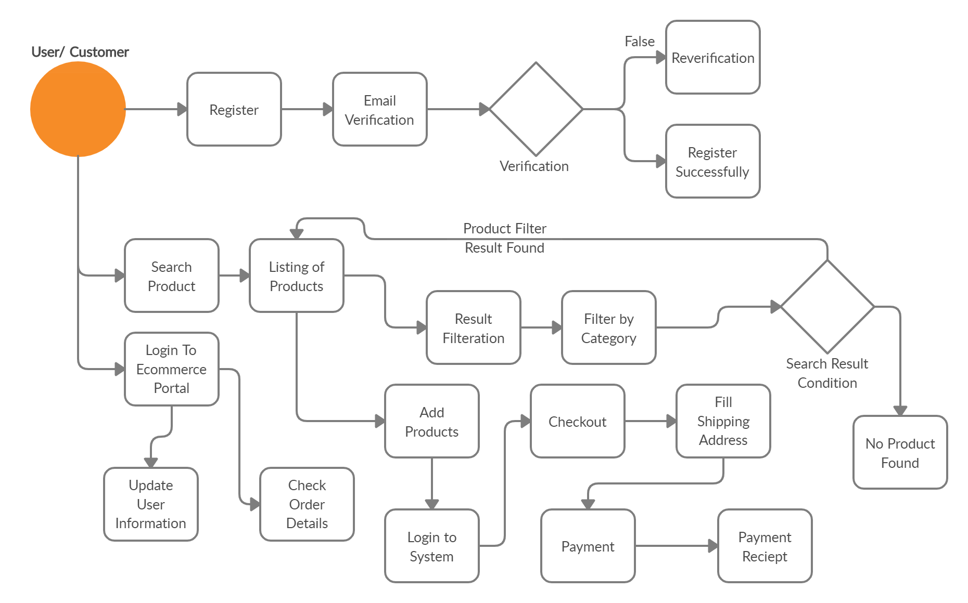
DFD of E-Commerce website
Level 1

Slide 13
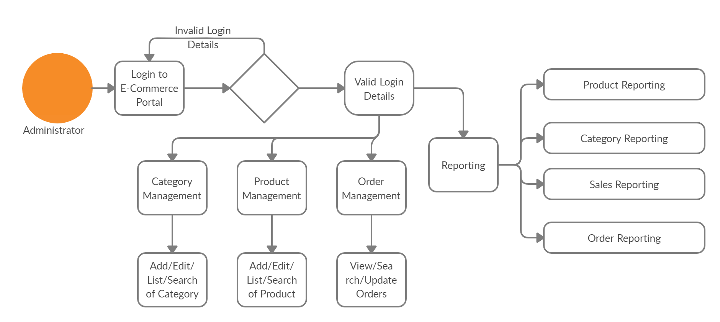
DFD of E-Commerce website
Level 2

Slide 14
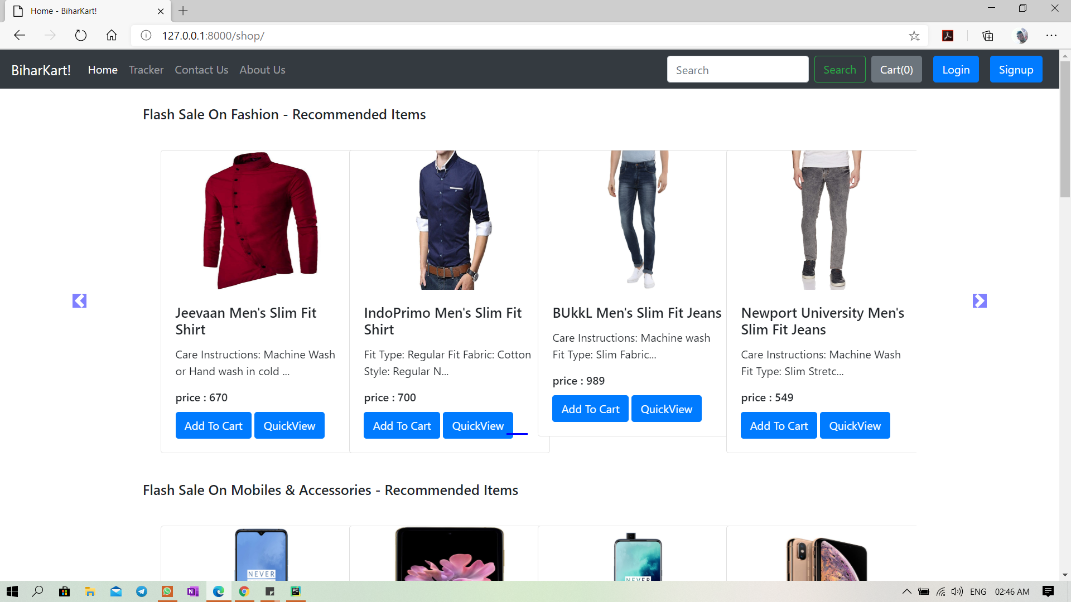
Screenshots of Web Application
Home Page

Slide 15
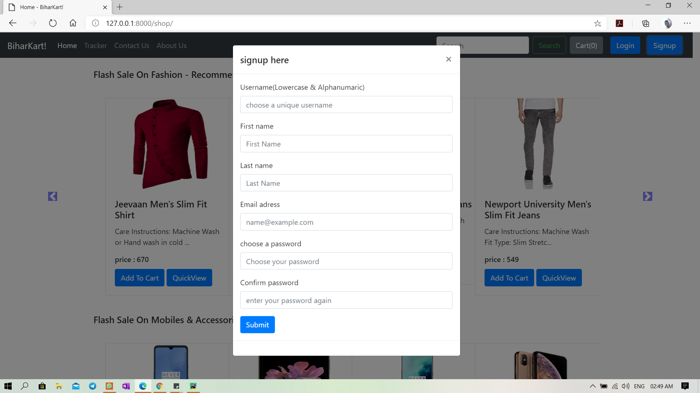
Screenshots of Web Application
Sign Up Page

Slide 16
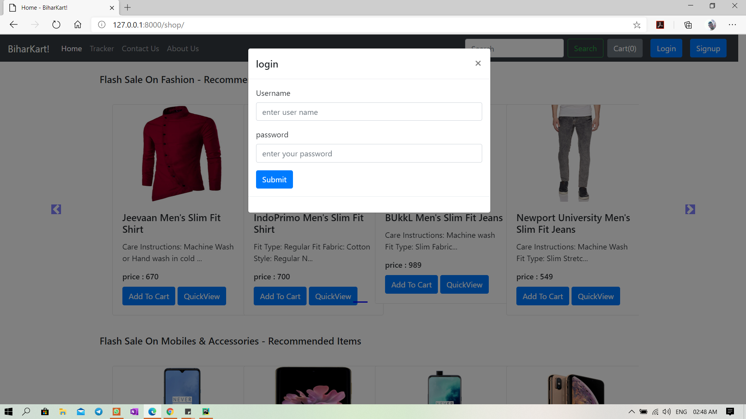
Screenshots of Web Application
Login Page

Slide 17
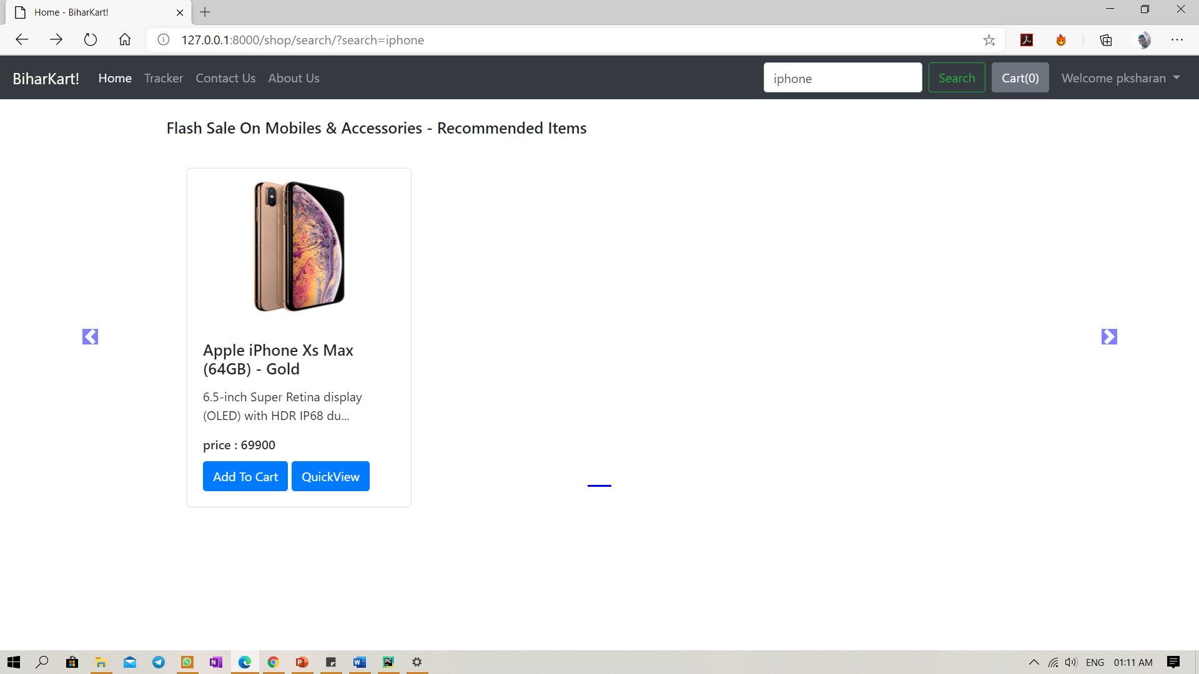
Screenshots of Web Application
Search Page

Slide 18
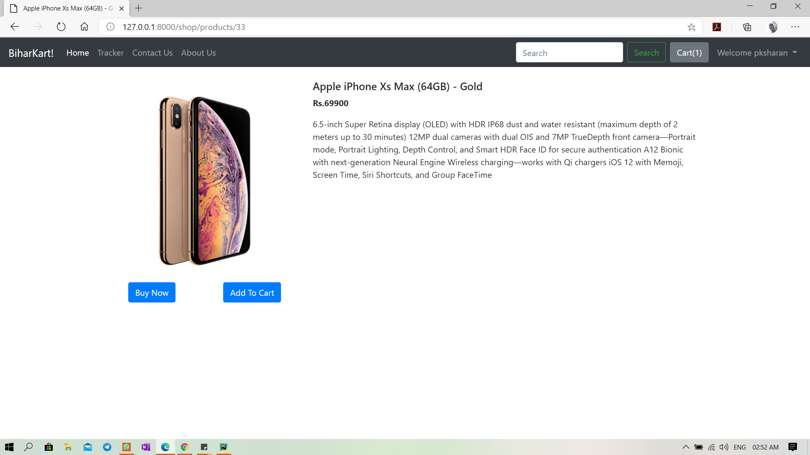
Screenshots of Web Application
Product View Page

Slide 19
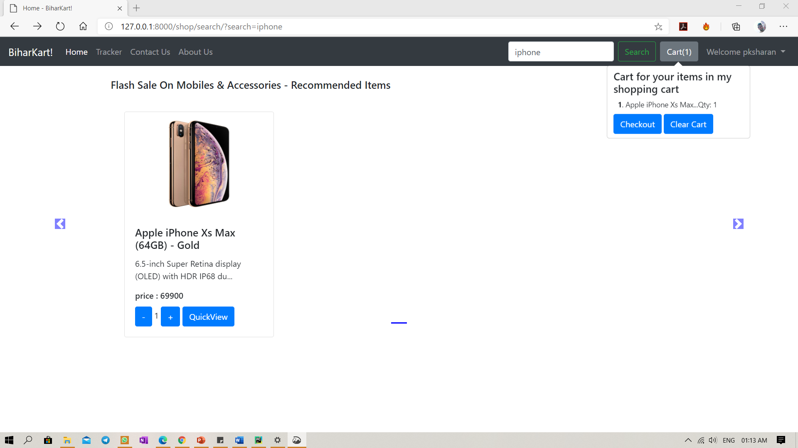
Screenshots of Web Application
Add to cart & Cart view

Slide 20
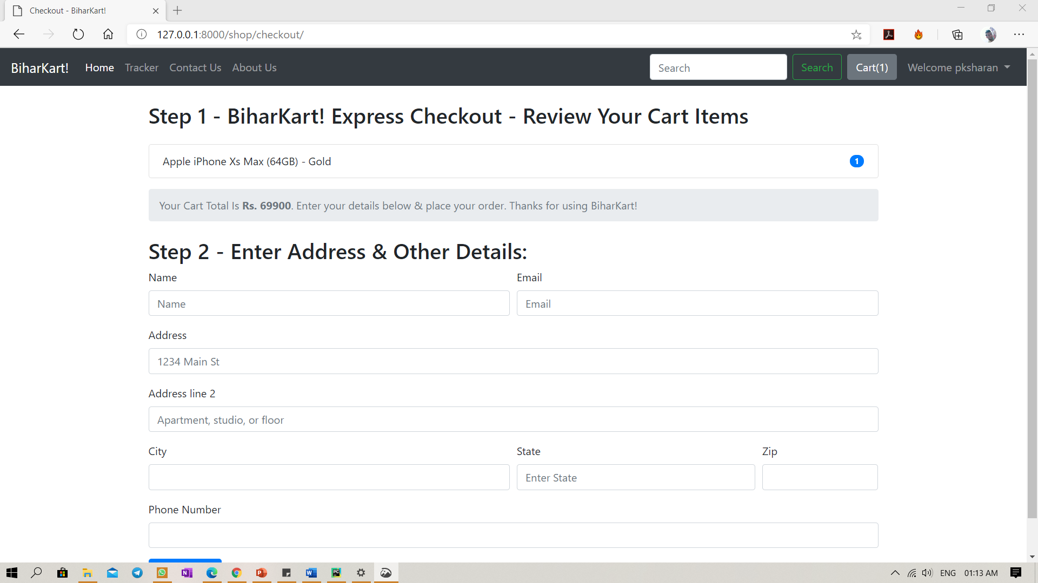
Screenshots of Web Application
CheckOut Page

Slide 21
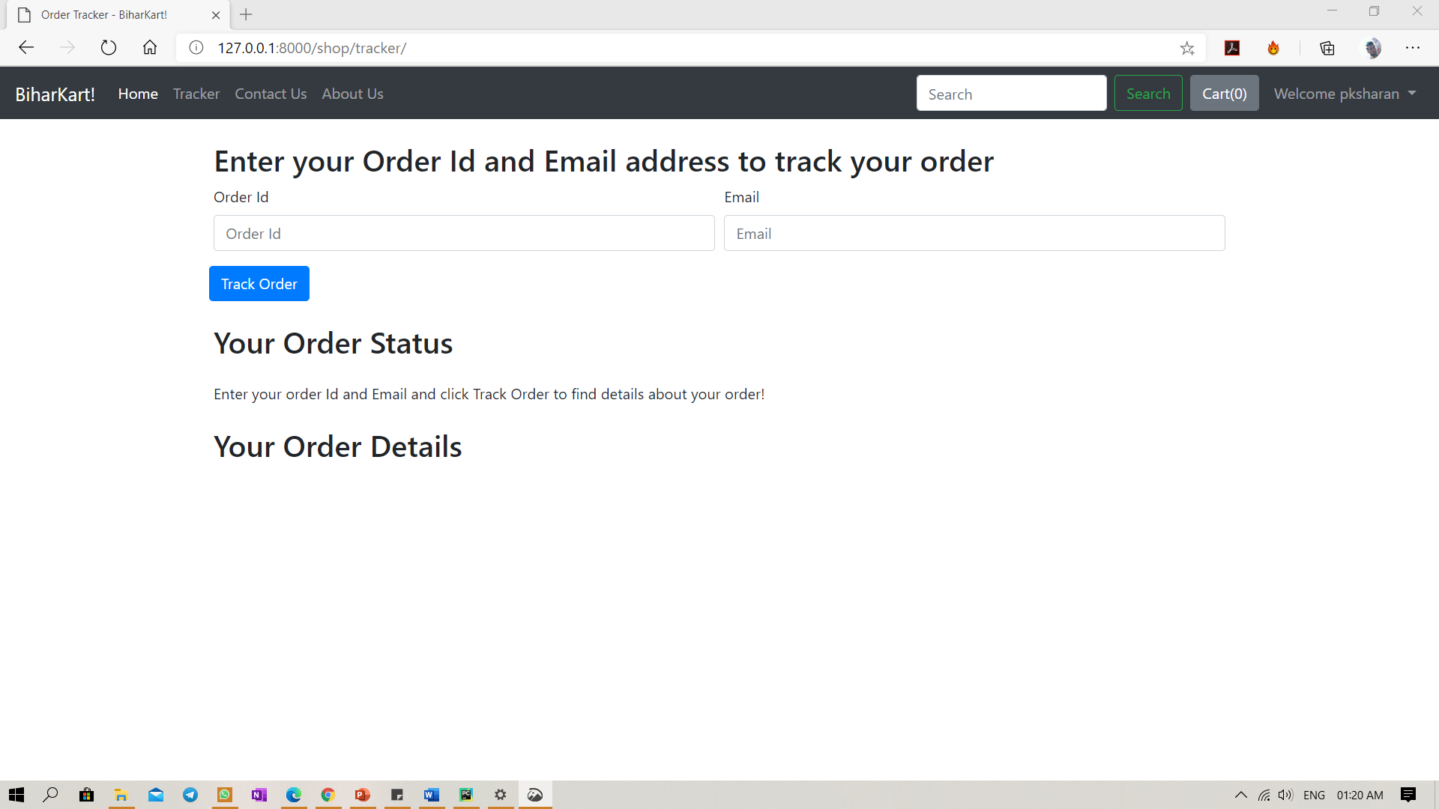
Screenshots of Web Application
Order Tracker Page

Slide 22
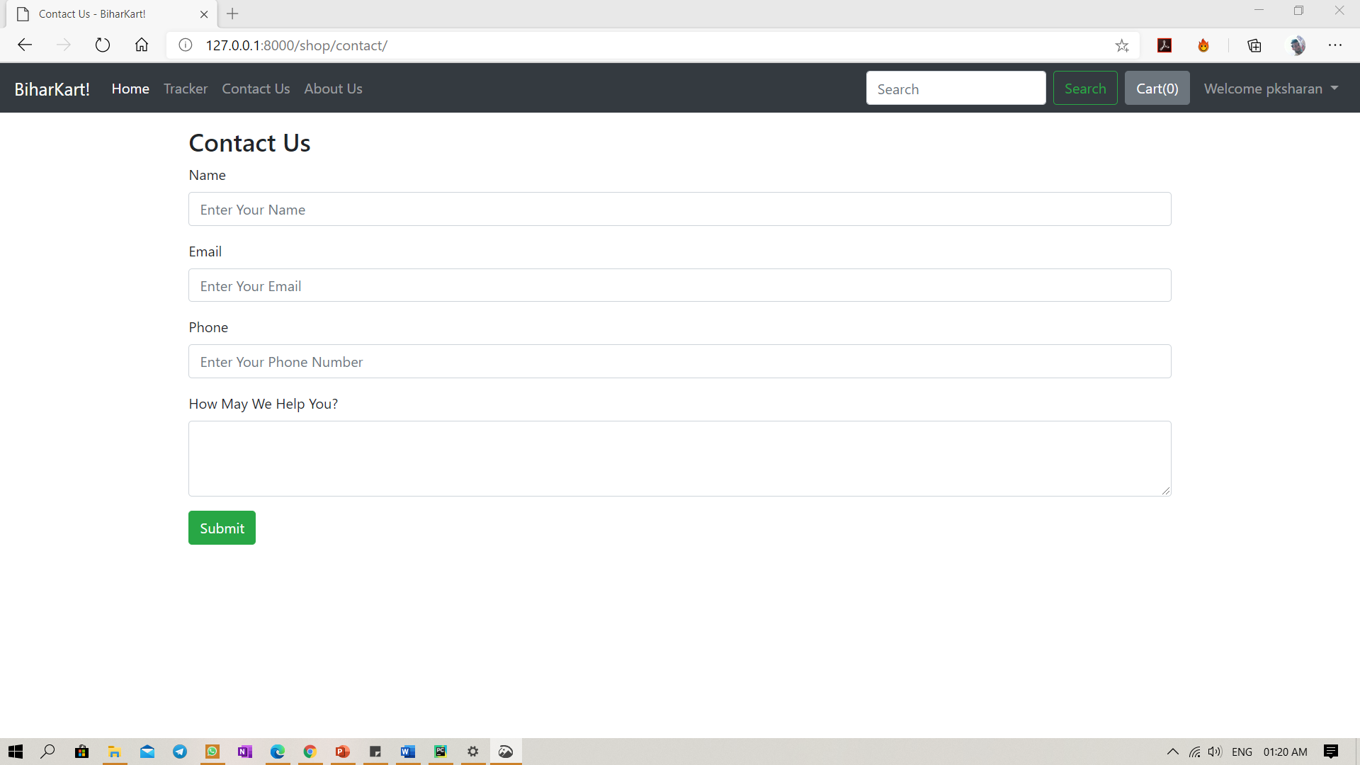
Screenshots of Web Application
Contact Us Page

Slide 23
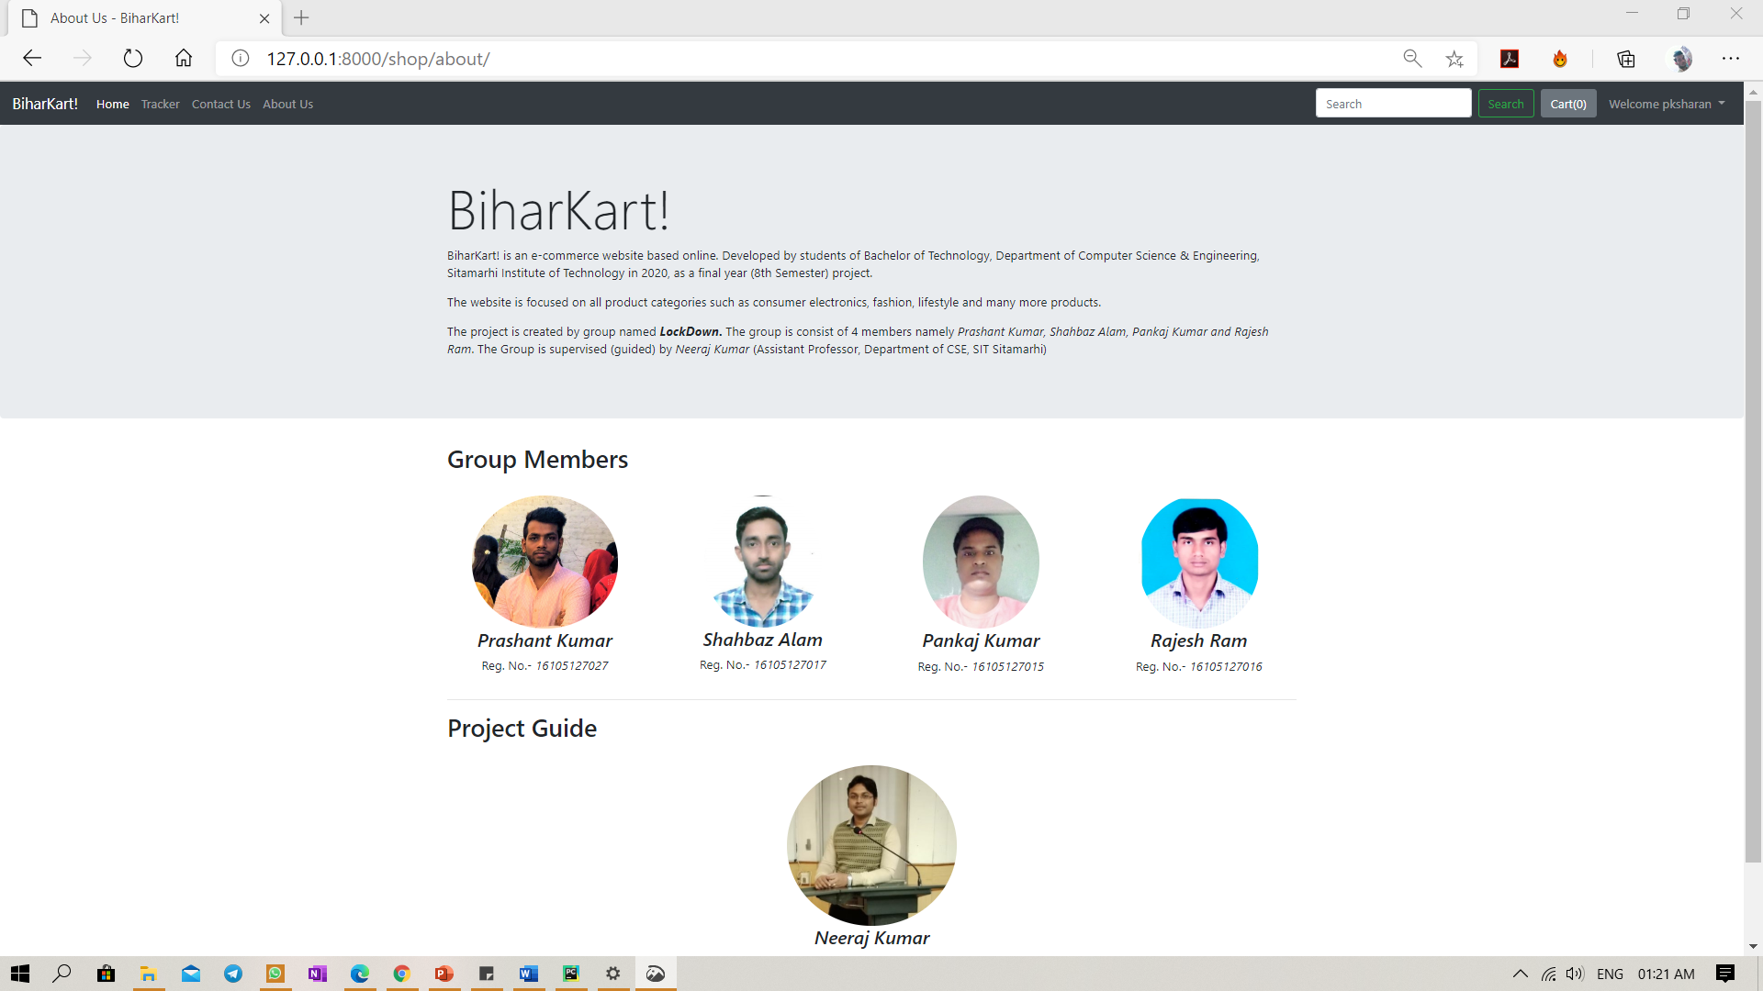
Screenshots of Web Application
About Us Page

Slide 24
CONCLUSION
E-commerce has undeniably become an important part of our society.
The world wide web is and will have a large part in our daily lives. It is therefore critical that small businesses have their own to keep in competition with the larger websites.
Since web developers have lowered down the prices for their services, it has become more affordable for small businesses to use the world wide web to sell their products.
Although there are negative aspects of e-commerce, small businesses have tried to accommodate to the needs of the consumers.
It is also important to note that e-commerce does not benefit all small companies equally.
How much revenue a business gets from e-commerce depends on what kind of service it gives.

Slide 25
FUTURE ENHANCEMENT
Today, the market place is flooded with several e-commerce options for shoppers to choose from.
A variety of innovative products and services are being offered spoiling customers for choice.
Online shopping is no more a privilege enjoyed by your friends and family living in US or UK. Today, it is a reality in India.
In the last couples of years, the growth of e-commerce industry in India has been phenomenal as more shoppers have started discovering the benefits of using this platform.
There is enough scope for online businesses in the future if they understand the Indian shopper’s psyche and cater to their needs.

Slide 26
REFERENCE
https://www.python.org/
https://www.djangoproject.com/
https://getbootstrap.com/
Dr. Shahid Amin, Prof. Keshav Kansana, Jenifur Majid. “A Review Paper on E-Commerce.” TIMS 2016-International Conference. Gwalior. 2016
Nitika goyal, Deepam Goyal. “Impact of E-Commerce in India: Issues & Challenges.” International Journal of Advanced Research in Computer Science. Volume 7, No. 6(Special Issue), November 2016
Ashok Panigrahi, Ranjan Upadhyaya, Dr. P. P. Raichurkar. “E-Commerce Services in India: Prospects and Problems.” International Journal on Textile Engineering and Processes. Vol 2, Issue 1, January 2016
Nisha Chanana, Sangeeta Goele. “Future of E-Commerce in India.” International Journal of Computing & Business Research. 2012
Raj Kumar Singh. “E-Commerce in India: Opportunities and Challenges.” Proceedings of 10th International Conference on Digital Strategies for Organizational Success. January 6, 2019
Dr. B Karunakar, Bisheswar Sinha. “E-Commerce in India.” International Journal of Management Research and Business Strategy. Volume 5, Issue 3, July 2016

Slide 27


